Slide 1
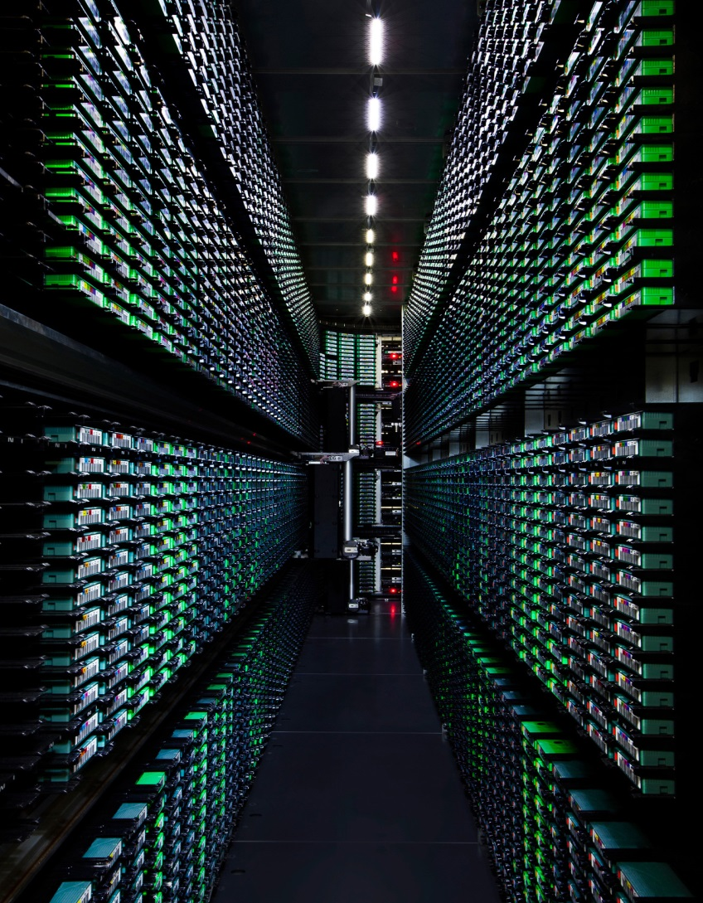

Main page ideas
Security
of your data is our first priority.
Notes:
Add to a slider for the website as one of many

Slide 2
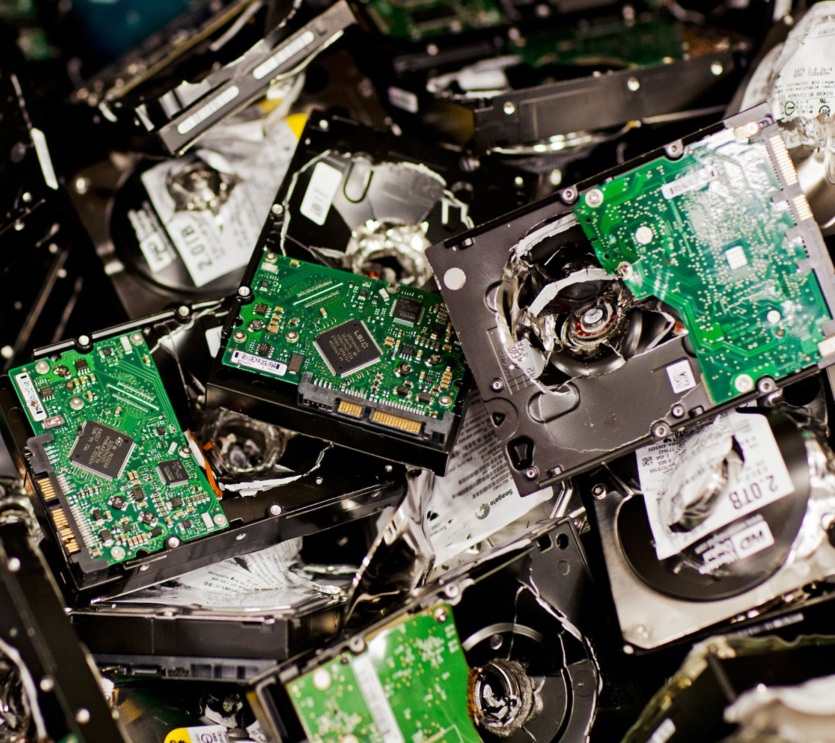
Protection of your data, is our job, and peace of mind for you.
Notes:
This message needs work; need to convey that the backup and recovery from a loss is important. We want the viewer to get that we will protect their data.

